Slide 1
AN INSIGHT INTO ALGAE LIPID PRODUCTION DYNAMICS USING COMPARTMENTAL MODEL APPROACH.
PAPER PRESENTED
BY
Engr. Onyia Chibuzo John.
NATIONAL CENTRE FOR TECHNOLOGY MANAGEMENT
15TH JANUARY, 2026
Managing Technology for sustainable Development

Slide 2

Introduction
Global Aviation Emissions
The aviation industry contributes 2.5% of global CO2 emissions, projected to triple by 2050. IATA mandates carbon-neutral growth from 2020 and a 50% reduction by 2050.
Sustainable Aviation Fuel, SAF From Microalgae the Promise
High Potential of Microalgae: Microalgae are a highly efficient oil source, capable of yielding 10-20 times more oil per unit area than land-based crops, with some strains exceeding 50% lipid content.
Addressing a Research Gap: While compartmental and SIR models have been used for algae growth, their application to Sustainable Aviation Fuel (SAF) production under tropical conditions remains unexplored.
·Focus on Nigeria: Nigeria's SAF industry is in early stages, but it is identified as a strategic component for the country's energy transition, creating a need for localized research.
Overall Aim: The research aims to create a computational model that accurately represents the entire process of algae cultivation, harvest, and conversion into SAF, filling a critical gap for tropical climates.
Novel Modeling Approach: This study develops a new five-compartment model (A, E, H, B, G) tailored specifically for simulating the dynamics of algae-based SAF production systems.

Slide 3
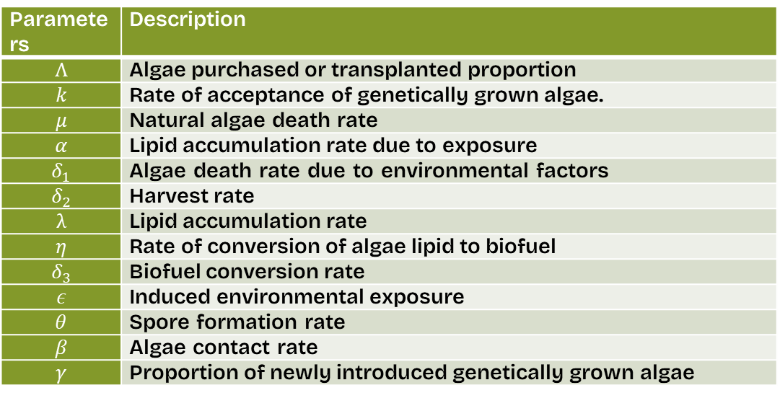
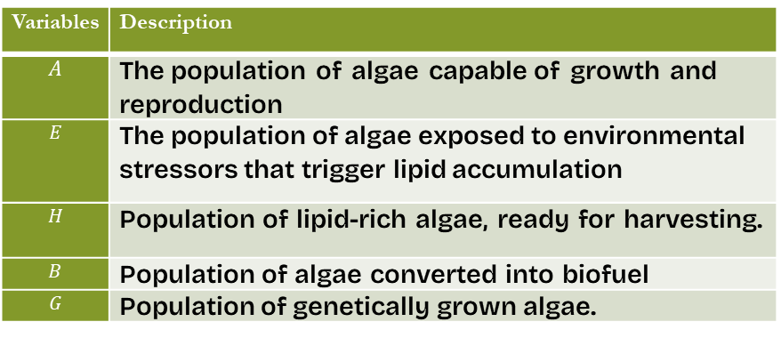
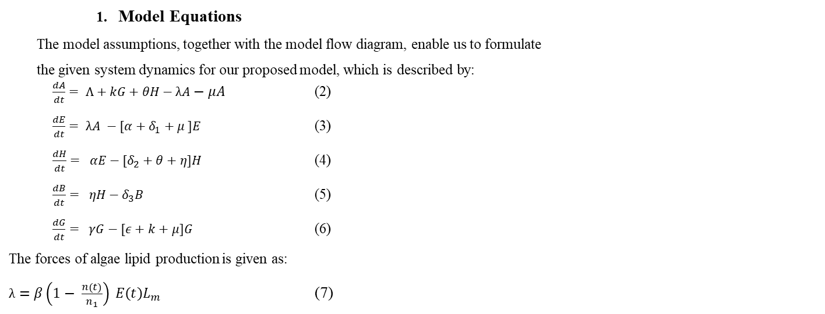
Model Formulations
αE(t)
ηH(t)
    Model Assumptions
      Homogeneous Chlorella vulgaris population. Algae can die naturally or as a result of environmental factors. Nutrient-dependent lipid accumulation. Transplanted algae can be introduced into the total algae community (farm). Some algae can be genetically modified.
Λ
λA(t)
Variables | Description
$$A$$ | The population of algae capable of growth and reproduction
$$E$$ | The population of algae exposed to environmental stressors that trigger lipid accumulation
$$H$$ | Population of lipid-rich algae, ready for harvesting.
$$B$$ | Population of algae converted into biofuel
$$G$$ | Population of genetically grown algae.
A(t)
θ
E(t)
H(t)
B(t)
µA(t)
κA(t)G(t)
(µ + δ₁)E(t)
(δ₂ + θ)H(t) δ₃B(t)
γ
G(t)
ϵG(t)
Figure 3.1: Flow diagram of algae lipid production dynamics
    Model Equations
The model assumptions, together with the model flow diagram, enable us to formulate
the given system dynamics for our proposed model, which is described by:
$\frac{dA}{dt}= Λ+kG+θH−λA−μA$ (2)
$\frac{dE}{dt}= λA −[α+δ_{1}+μ ]E$ (3)
$\frac{dH}{dt}= αE−[δ_{2}+θ+η]H$ (4)
$\frac{dB}{dt}= ηH−δ_{3}B$ (5)
$\frac{dG}{dt}= γG−[ε+k+μ]G$ (6)
The forces of algae lipid production is given as:
$λ=β\left(1− \frac{n\left(t\right)}{n_{1}}\right) E\left(t\right)L_{m}$ (7)
Parameters | Description
$$Λ$$ | Algae purchased or transplanted proportion
$$k$$ | Rate of acceptance of genetically grown algae.
$$μ$$ | Natural algae death rate
$$α$$ | Lipid accumulation rate due to exposure
$$δ_{1}$$ | Algae death rate due to environmental factors
$$δ_{2}$$ | Harvest rate
$$λ$$ | Lipid accumulation rate
$$η$$ | Rate of conversion of algae lipid to biofuel
$$δ_{3}$$ | Biofuel conversion rate
$$ε$$ | Induced environmental exposure
$$θ$$ | Spore formation rate
$$β$$ | Algae contact rate
$$γ$$ | Proportion of newly introduced genetically grown algae

Slide 4
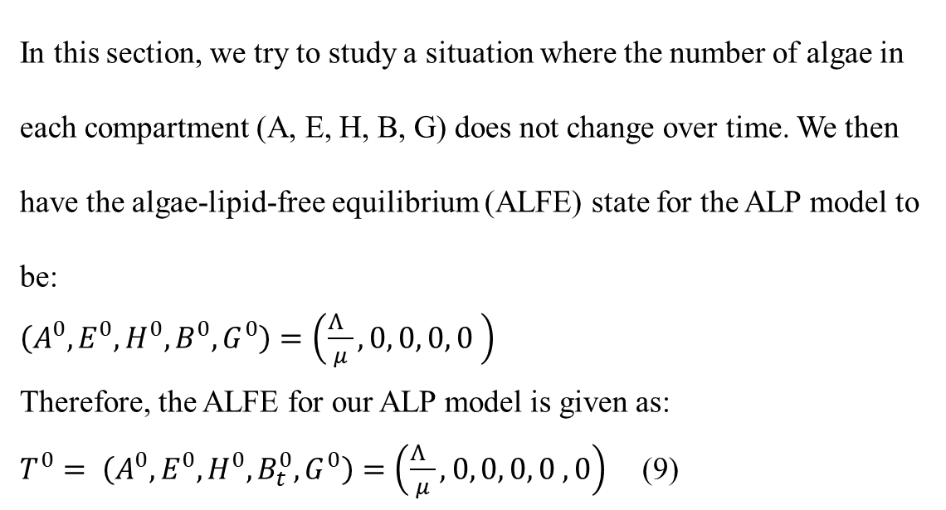
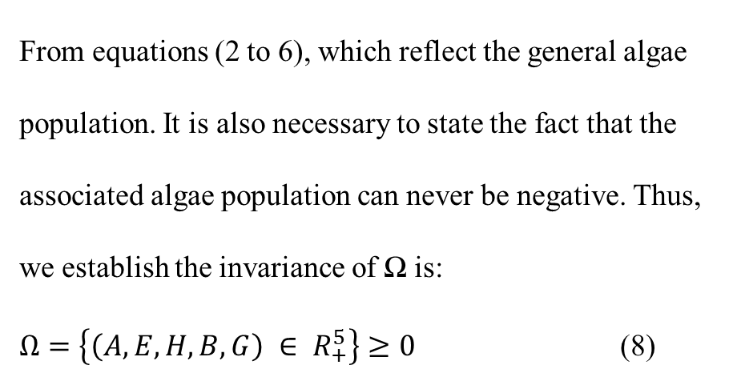
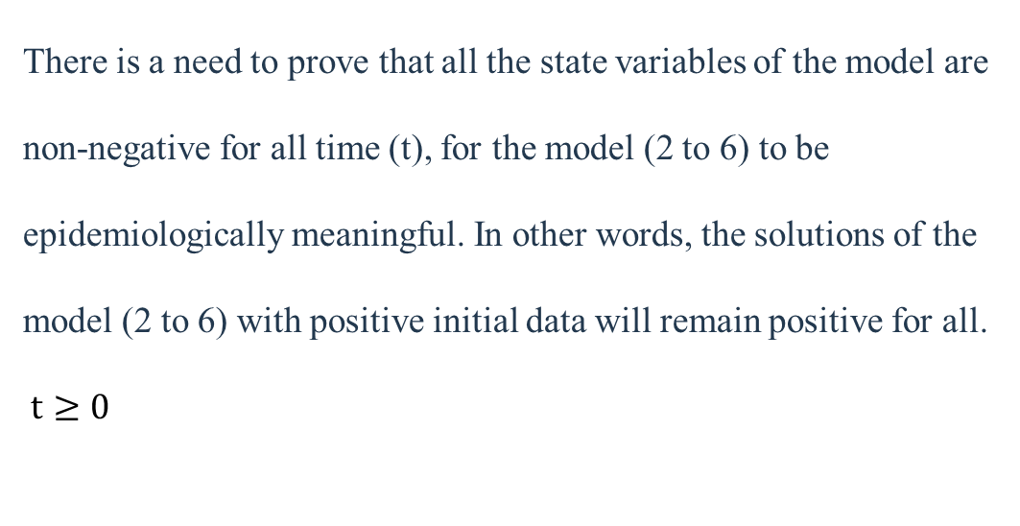
Analysis, Discussion Of Results, And Simulations
Invariant Region Solution
From equations (2 to 6), which reflect the general algae population. It is also necessary to state the fact that the associated algae population can never be negative. Thus, we establish the invariance of Ω is:
$Ω=\left\{\left(A, E, H, B, G\right) ∈ R_{+}^{5}\right\}≥0$ (8)
Establishing the algae-lipid-free equilibrium (ALFE) points for the General Model
In this section, we try to study a situation where the number of algae in each compartment (A, E, H, B, G) does not change over time. We then have the algae-lipid-free equilibrium (ALFE) state for the ALP model to be:
$\left(A^{0}, E^{0}, H^{0}, B^{0}, G^{0}\right)=\left(\frac{Λ }{μ}, 0, 0, 0, 0 \right)$
Therefore, the ALFE for our ALP model is given as:
$T^{0}= \left(A^{0}, E^{0}, H^{0}, B_{t}^{0}, G^{0}\right)=\left(\frac{Λ }{μ}, 0, 0, 0, 0 , 0\right)$ (9)
Positivity of Solution
There is a need to prove that all the state variables of the model are non-negative for all time (t), for the model (2 to 6) to be epidemiologically meaningful. In other words, the solutions of the model (2 to 6) with positive initial data will remain positive for all. $t≥0$

Slide 5
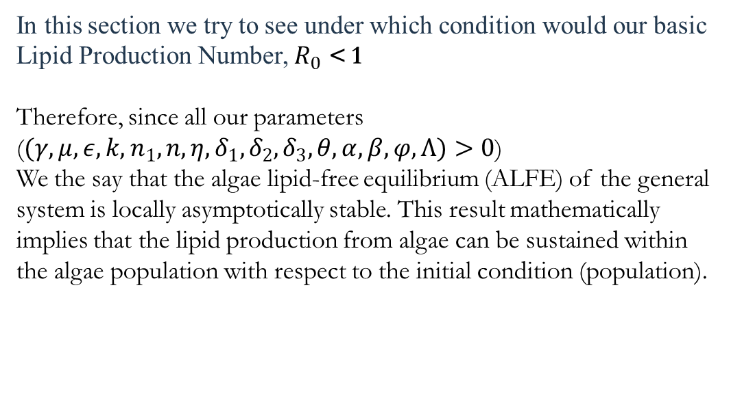
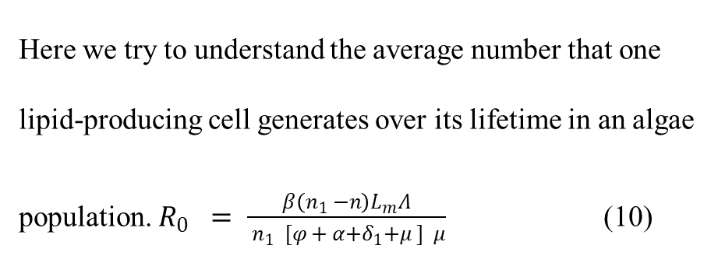
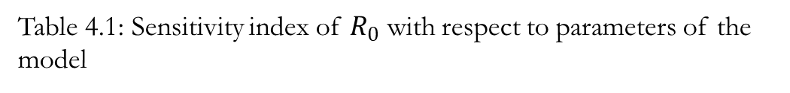
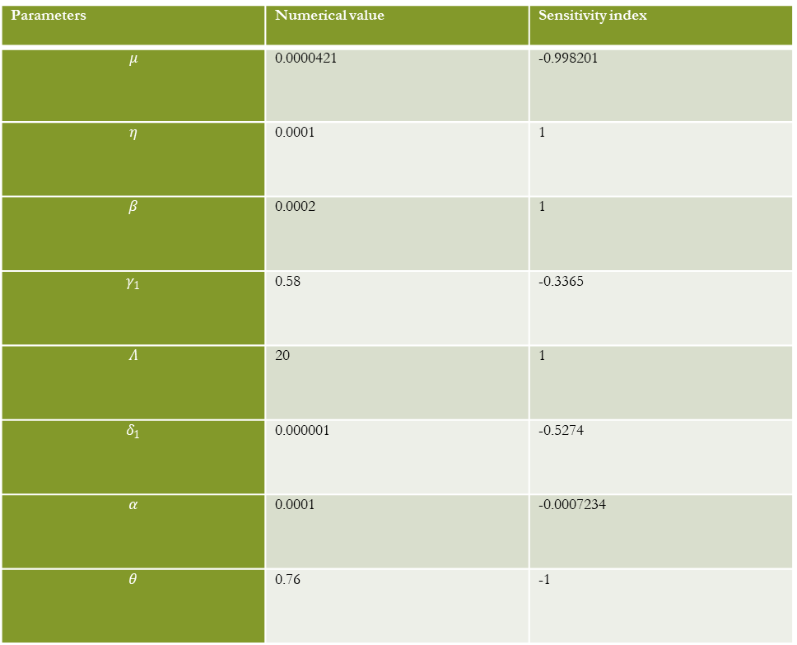
Analysis, Discussion Of Results, And Simulations
The Basic Lipid Reproduction Number (R₀) for the Study
Sensitivity Analysis of the General Algae Lipid Production (ALP) Model with respect to R0
Here we try to understand the average number that one lipid-producing cell generates over its lifetime in an algae population. $R_{0} = \frac{β\left(n_{1} −n\right)L_{m}Λ}{ n_{1} [φ + α+δ_{1}+μ ] μ}$ (10)
Table 4.1: Sensitivity index of $R_{0}$ with respect to parameters of the model
Parameters | Numerical value | Sensitivity index
$$μ$$ | 0.0000421 | -0.998201
$$η$$ | 0.0001 | 1
$$β$$ | 0.0002 | 1
$$γ_{1}$$ | 0.58 | -0.3365
$$Λ$$ | 20 | 1
$$δ_{1}$$ | 0.000001 | -0.5274
$$α$$ | 0.0001 | -0.0007234
$$θ$$ | 0.76 | -1
Local Stability Analysis of Algae-Lipid Free Equilibrium (ALFE) State of the General Model
In this section we try to see under which condition would our basic Lipid Production Number, $R_{0}$ < 1
Therefore, since all our parameters ($(γ,μ, ε,k,n_{1},n, η, δ_{1},δ_{2},δ_{3}, θ,α,β,φ,Λ)>0$)
We the say that the algae lipid-free equilibrium (ALFE) of the general system is locally asymptotically stable. This result mathematically implies that the lipid production from algae can be sustained within the algae population with respect to the initial condition (population).

Slide 6
4.8 Sensitivity Analysis of the General Algae Lipid Production (ALP) Model with respect to R₀
We use the normalized forward-sensitivity index of a variable,
, that depends on a parameter,
, which is expressed as:
In particular, this analysis sought the sensitivity indices of thebasic reproduction number,
, with respect to the model parameter of interest to be examined
The positive sign of sensitivity indices of
to the model parameters illustrates that an increase (or decrease) in the value of each of the parameter in the model,
may lead to an increase (or decrease) in
of the model (2) to (6) and asymptotically result into persistency (or elimination) of the algae lipid produced in the area.
On the contrary, the negative sign of S.I of
to the model parameter indicates that an increase (or decrease) in the value of each of the parameter in each case
leads to a corresponding decrease (or increase) in
of the model of (2) to (6). Hence, with sensitivity analysis, one can get insight on the appropriate intervention strategies
to prevent and control the algae lipid production described in the model in equations (2) to (6).

Slide 7
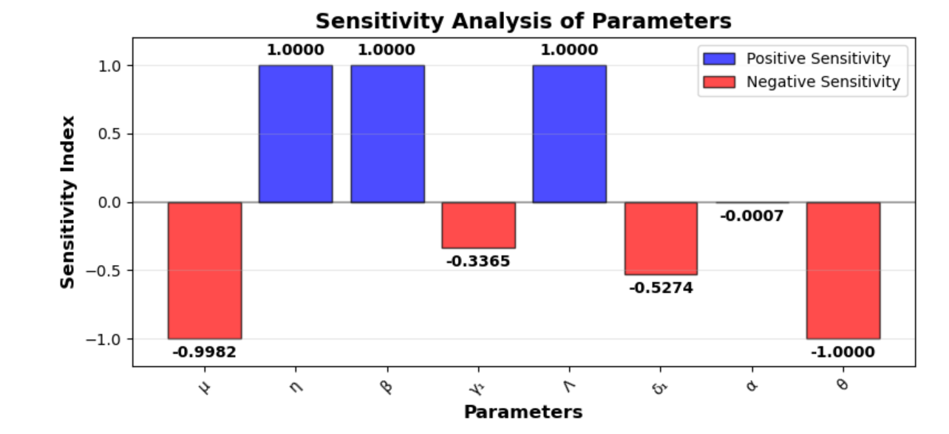
4.9 Model Simulation and Explanation
Here, we verified the mathematical representation for our algae lipid production dynamics by varying parameters to get a deeper understanding of how different parameters influence the production of algae lipid.
Figure 4.1 presents a bar plot graph of the sensitivity index, illustrating how small changes in different model parameters can help predict their impact on the average lipid production output (R₀) in algae. The green represents positive bar plots, which indicate that increasing these positive parameters will increase lipid production. In contrast, the negative bar plots are given a red color, meaning that increasing this parameter will decrease lipid production, and vice versa.
Figure 4.1: Graph showing the Sensitivity index analysis of the R₀ for our proposed model.

Slide 8
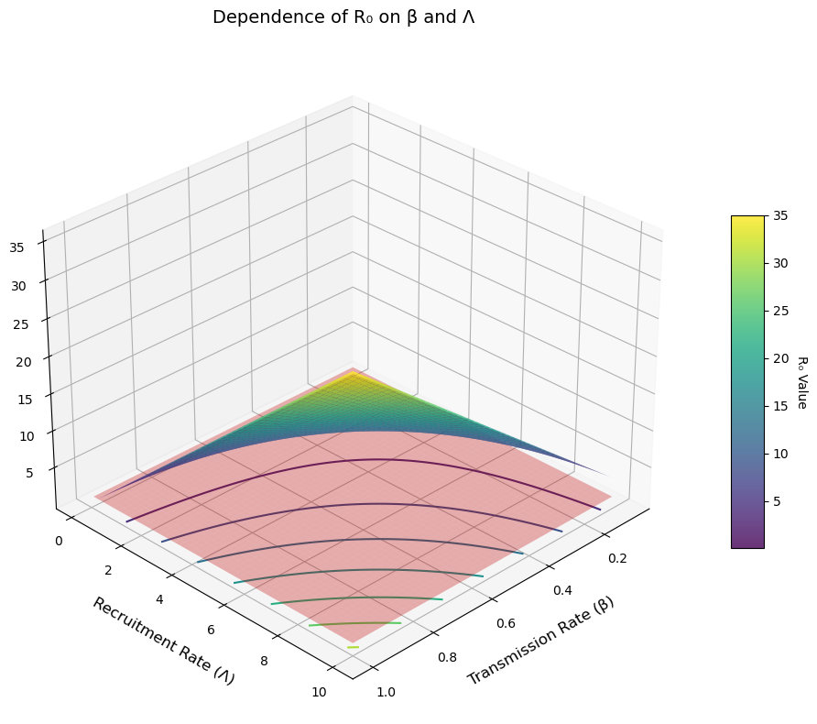

In Fig. 2, we try to visualize the relationship between the parameters, Ʌ and β with respect to a given R0 value. The graph then shows us how β, which is the lipid transmission rate, makes us understand how efficient the algae are at producing lipid oil. Also, Λ, which is the new algae recruitment rate, tells us how many new algae contribute to the production of lipid in the lipid production system each day. Once either Ʌ, or β value goes down, Lipid production will decline over time because each productive algae cell does not replace itself with at least one equally productive cell. Eventually, production will stop.
Fig 2: Relationship between $Ʌ , β$ and R₀.

Slide 9
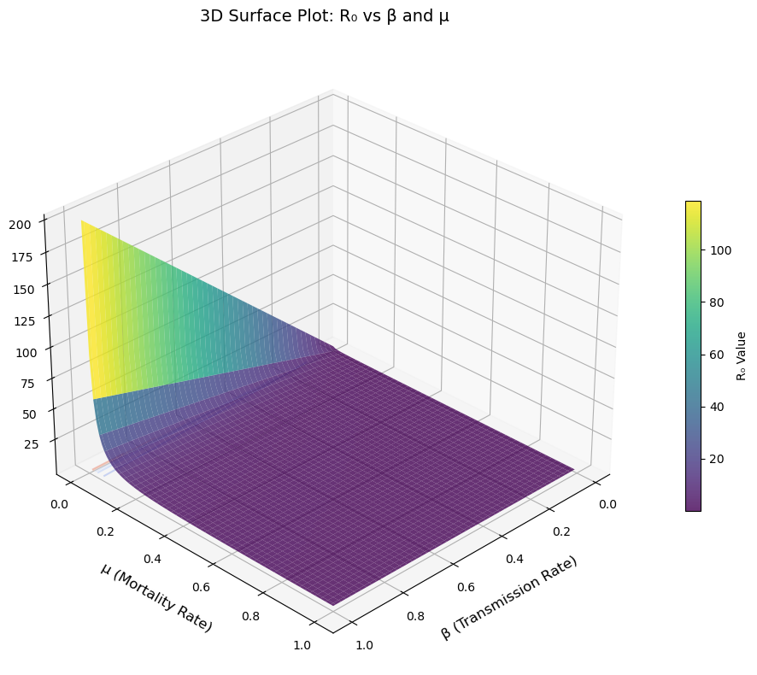

From Fig. 3, we have a plot for the algae lipid production dynamics model. This plot shows the relationship between "μ", "β", and " R₀" as we try to visualize their behavior as the values of each of them change. This graphical representation of our algae model tells us that to maximize algae lipid production, the single most important thing to focus on is optimizing the algae's environment for growth (β). This means ensuring they have perfect access to light, carbon dioxide, and other nutrients. While keeping the algae healthy to minimize death (μ) is still important, the gains from making them grow efficiently are far more significant.
Fig 3: Relationship between $μ , β$ and R₀.

Slide 10
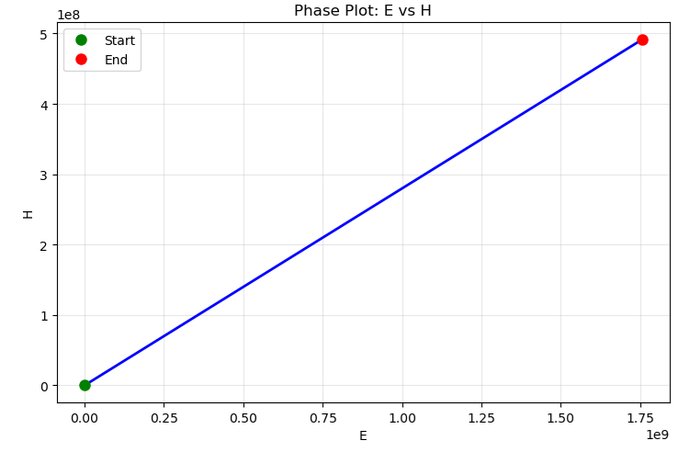
From Fig. 4, we have a plot for the algae lipid production dynamics model. This plot shows the relationship between harvesting too little, which leaves potential unused resources. Harvesting too much crashes both the natural population and your future harvest.. There is a perfect, sustainable balance to aim for (the equilibrium point), which maximizes long-term yield without destroying the resource.
Fig 4: Graph of the Phase plot of E against H

Slide 11
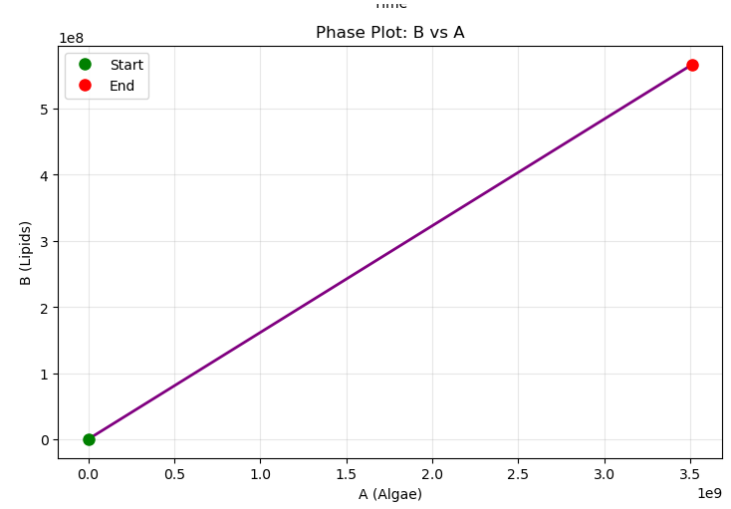
From Fig. 5, we have a plot for the algae lipid production dynamics model. This plot shows the relationship between lipids and algae’s population, which leaves potential unused resources.
Fig 5: Graph of the Phase plot of E against H

Slide 12
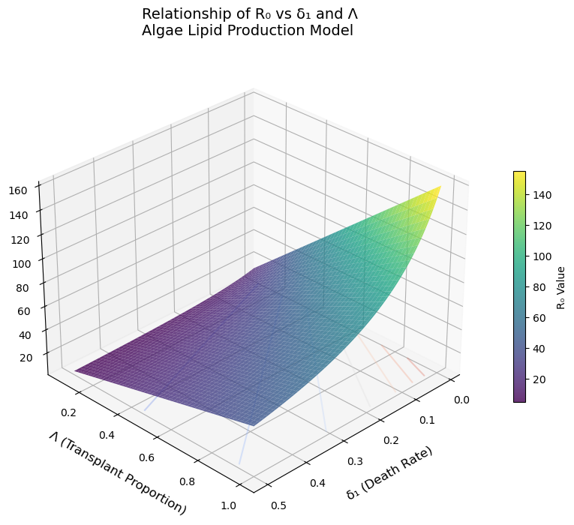
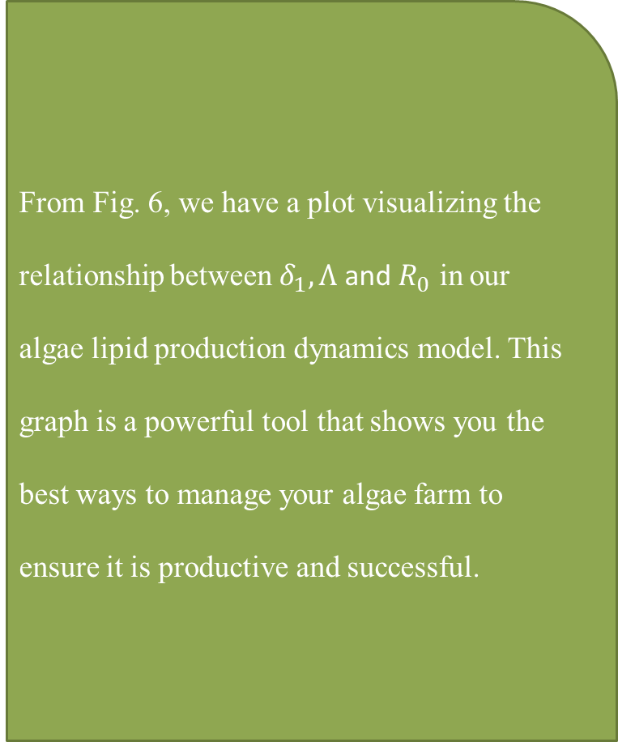
From Fig. 6, we have a plot visualizing the relationship between $δ_{1}, Λ$ and $R_{0}$ in our algae lipid production dynamics model. This graph is a powerful tool that shows you the best ways to manage your algae farm to ensure it is productive and successful.
Fig 6: 3D plot showing the relationship between $δ_{1}, Λ$ and $R_{0}$

Slide 13
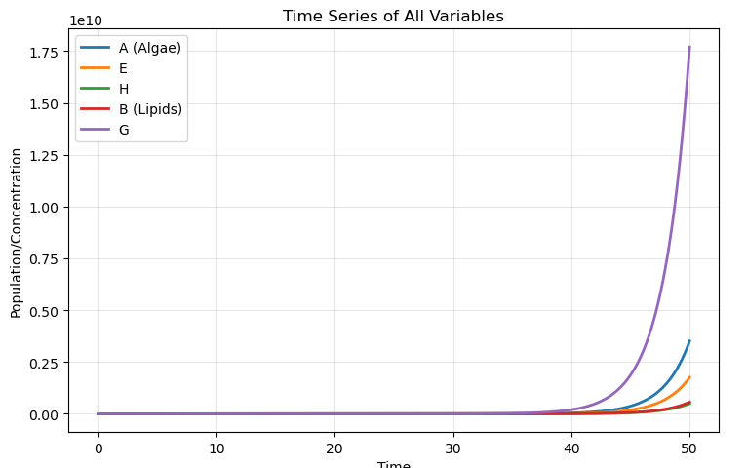
Figure 4.7, shows us plot that demonstrates a successful algae cultivation system where biomass is first established, then efficiently converted into valuable lipids for biofuel production, with the genetically modified strain providing stable underlying support to the process.
Figure 7: Graph showing Algae Lipid production dynamics

Slide 14
SUMMARY, CONCLUSION, AND RECOMMENDATION
Summary of the Research
This research addressed the critical challenge of decarbonizing the aviation sector, specifically within the Nigerian context, by developing a novel mathematical model to analyze and optimize the production of Sustainable Aviation Fuel (SAF) from microalgae.
The study formulated a deterministic compartmental model by extending the SIR-compartmental model approach to simulate the dynamics of algae lipid production.
The population was divided into five key compartments: Algae capable of growth (A), Algae exposed to lipid-triggering stressors (E), Lipid-rich algae ready for harvest (H), Algae converted to biofuel (B), and Genetically modified algae (G).
A core component of the model was the force of lipid accumulation, λ, which depends on the algae contact rate (β), lipid capacity ($n_{1}$), and maximum lipid production rate (Lₘ).
A core component of the model was the force of lipid accumulation, λ, which depends on the algae contact rate (β), lipid capacity (𝒏_𝟏), and maximum lipid production rate (Lₘ).
Conclusion
By developing a robust computational framework that accurately describes the complex dynamics of algae growth, lipid accumulation, and harvesting for SAF production the model provides a powerful tool to understand the non-linear interactions within the production system.
The derivation of the basic reproduction number R₀ is a fundamental outcome, serving as a single, powerful metric to assess the viability and efficiency of any given algae-to-SAF production system.
The research concludes that sustainable, large-scale algae lipid production is theoretically feasible but is acutely sensitive to environmental stressors and mortality factors.
For Nigeria and similar tropical nations, the model highlights that overcoming technical barriers related to maintaining healthy algae cultures in a fluctuating climate is a more significant hurdle than the initial biomass input.
The model establishes a critical foundation for optimizing algae-based biofuel pathways, moving from theoretical potential to practical, scalable strategy design.

Slide 15
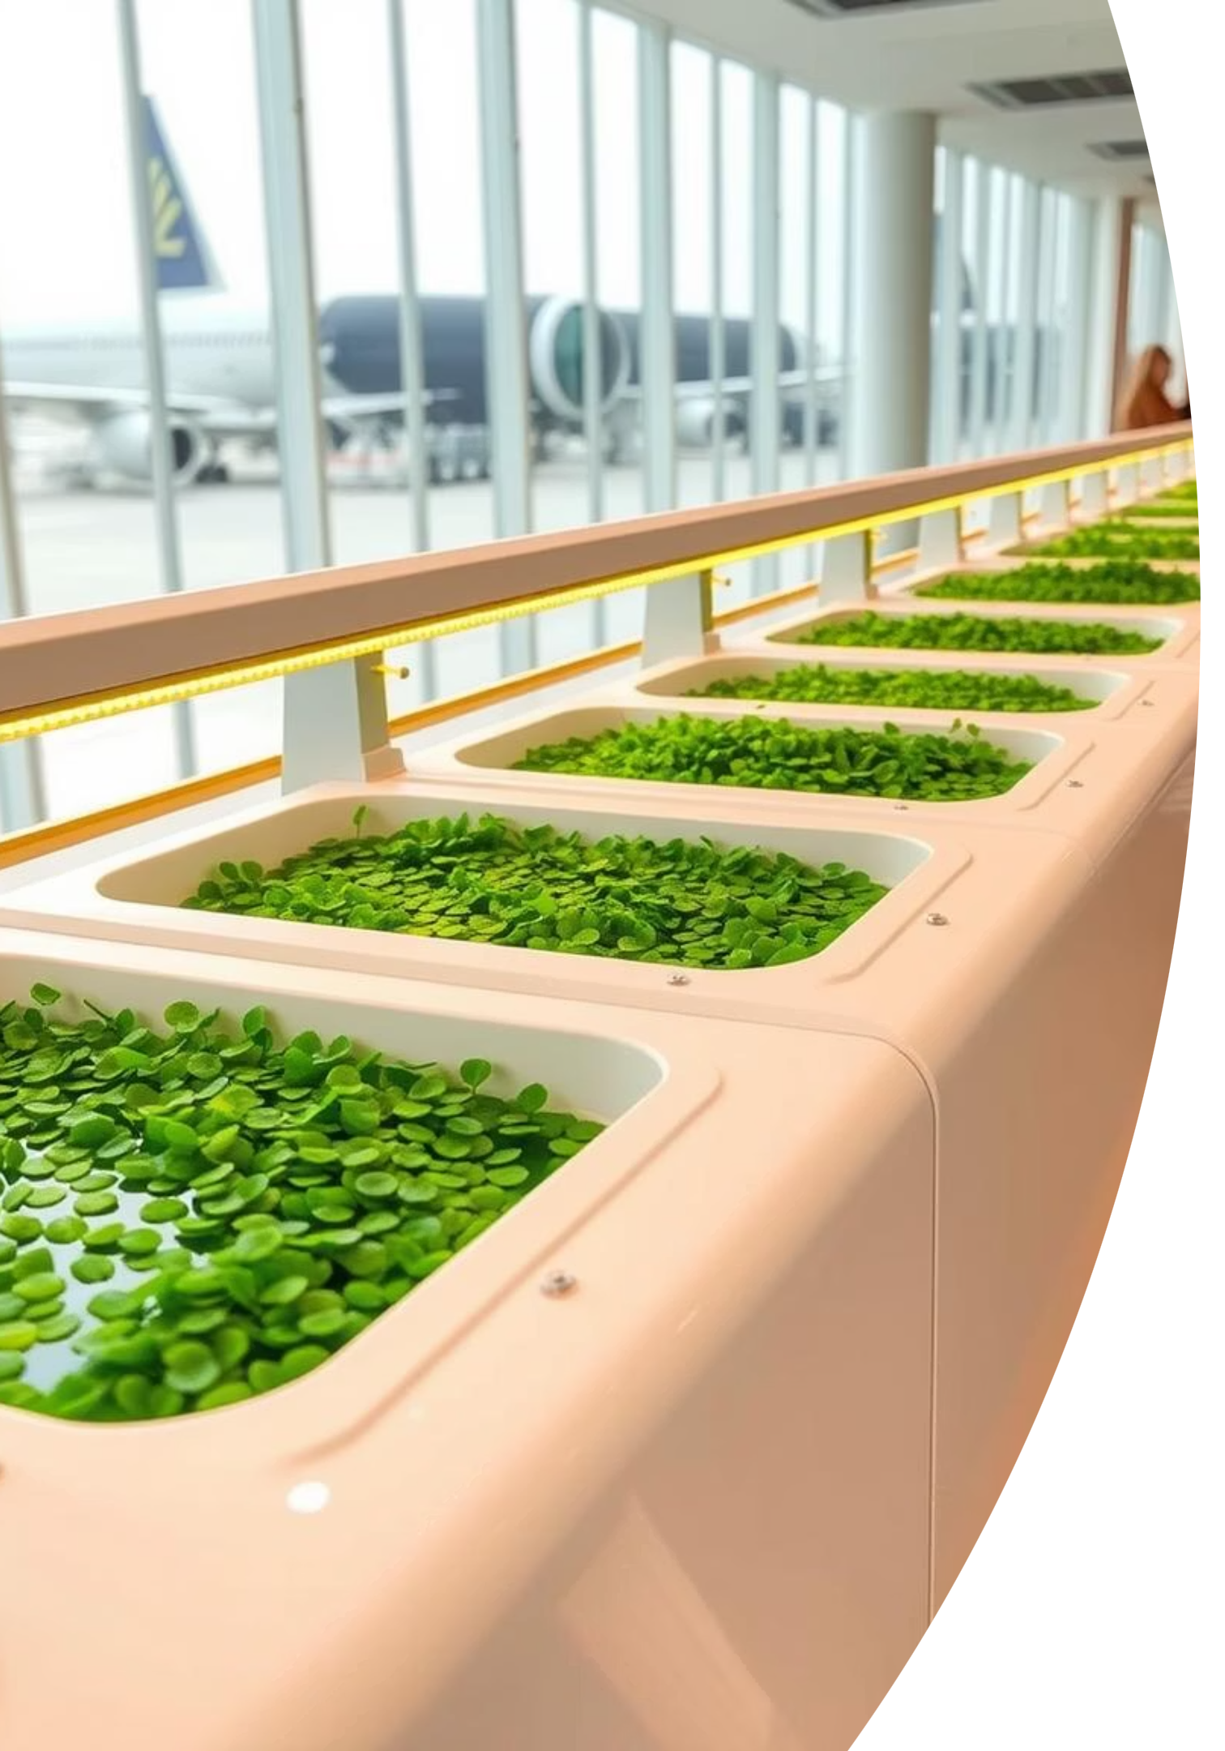
Key Takeaways
Global Imperative: SAF is crucial for decarbonizing aviation, with microalgae offering significant advantages.
Nigerian Potential: Despite current challenges, Nigeria has ideal conditions and resources for microalgae-based SAF.
Modeling Innovation: This study provides a novel mathematical model and analytical framework to optimize SAF production in tropical environments.
Future Impact: Findings will benefit researchers, policymakers, and industry in advancing sustainable bioenergy solutions.

Slide 16

THANK YOU FOR YOUR ATTENTION
THE END

